Slide 1
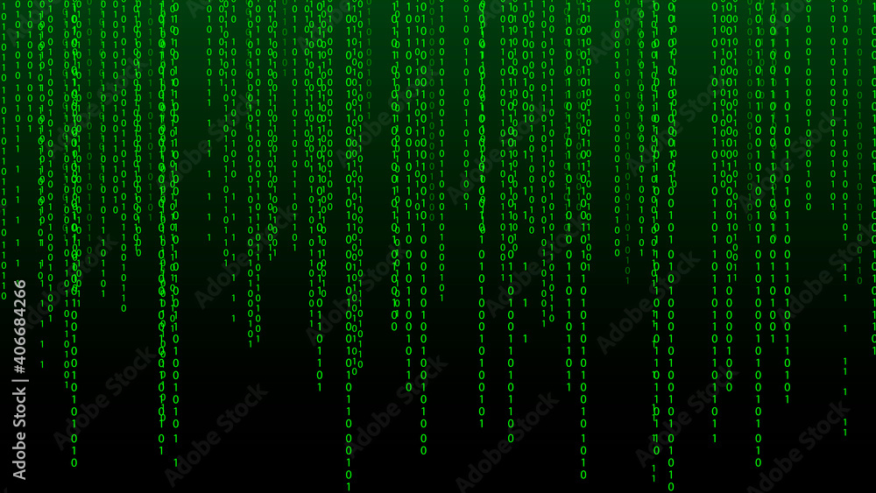
Data Science and Coding
Geog4/6300: Fall 2026
Dr. Shannon

Slide 2

What words do you think of when you think of statistics?
https://www.menti.com/alf1iff3dbnv
Notes:
Raster data

Slide 3
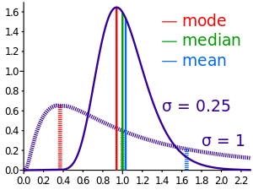
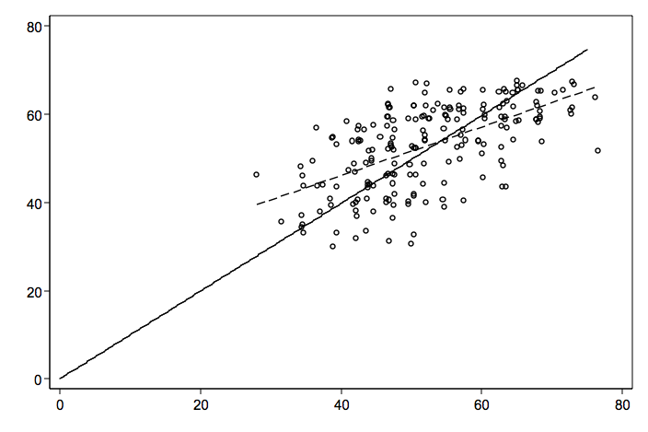
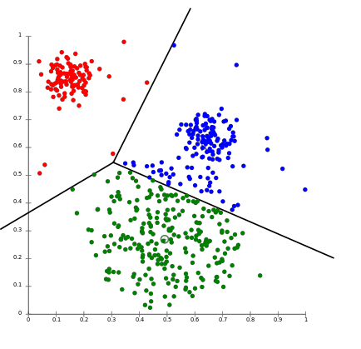
Types of statistics
Notes:
Raster data

Slide 4
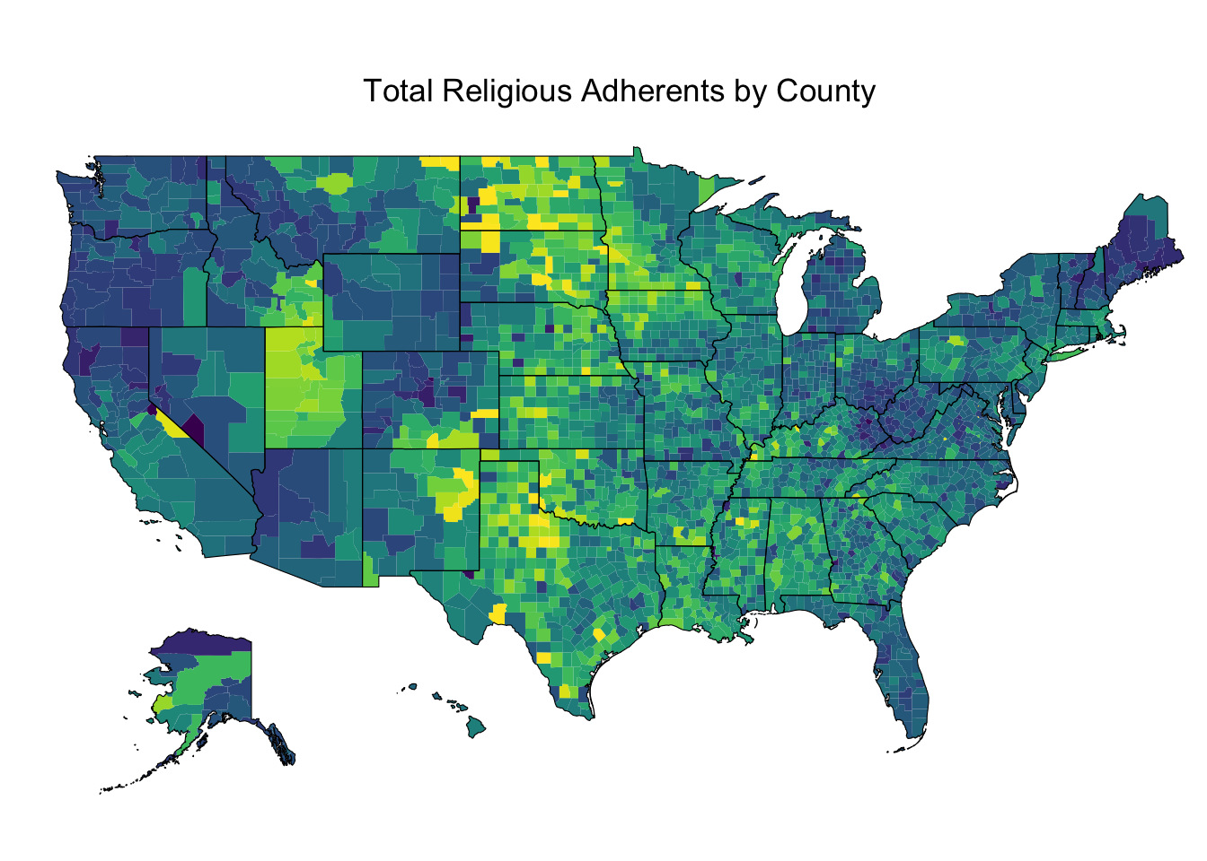
Descriptive statistics
Central tendency
Distribution
Change over time
Data visualization/exploratory analysis
Notes:
Raster data
Comprised of raster cells—all the same size and all with a value
This data is always continuous and there are no discrete units—a single point or area.
Disclaimer: most of my work has been with vector based data
Common raster maps? Temperature data (interpolated), land cover, classified remote sensing imagery
Questions you could ask of a land cover map—what percentage of an area is covered by various land cover types. What’s the relationship between type of land cover and other characteristics: elevation, proximity to certain features, etc.?

Slide 5
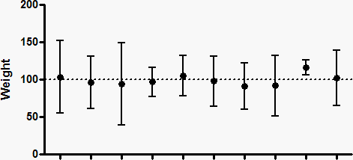
Inferential statistics
Difference in means/t-tests
Confidence intervals
Correlation
Regression
Machine learning
Clustering

Slide 6
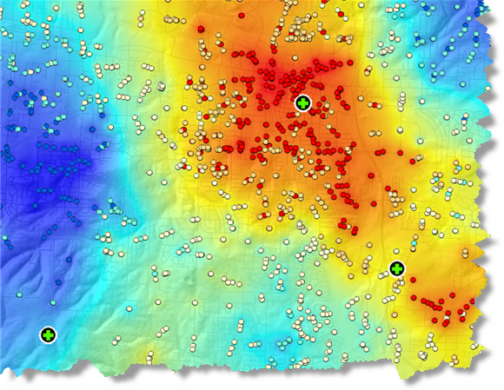
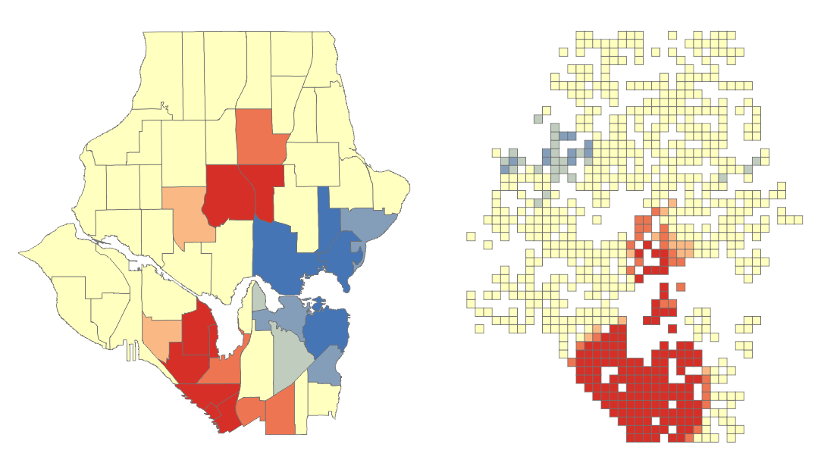
Spatial statistics
Spatial autocorrelation/Hotspot analysis
Spatial clustering
Geographic regression models

Slide 7
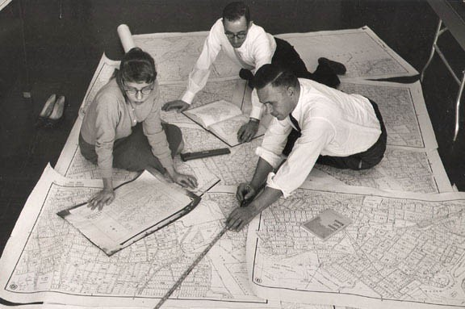
What’s distinctive about statistics in geography?
Notes:
Difference between descriptive and inferential statistics.
Example: rates of cancer in all state counties.

Slide 8
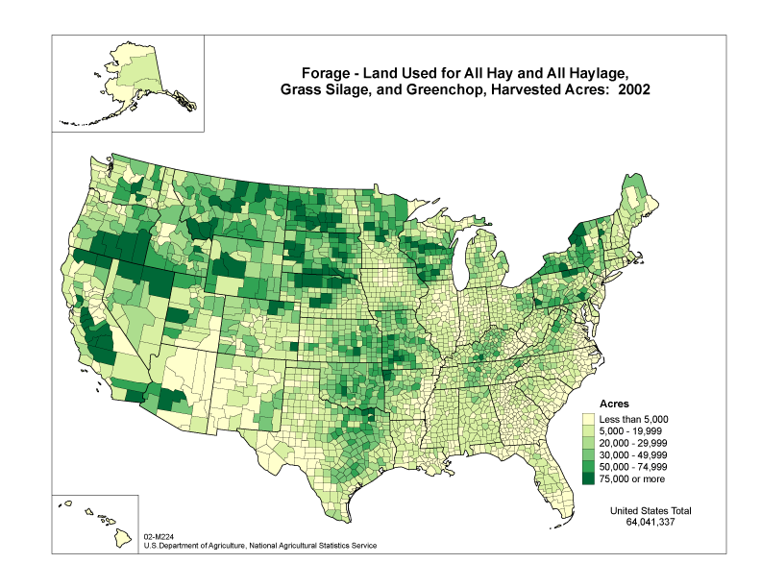
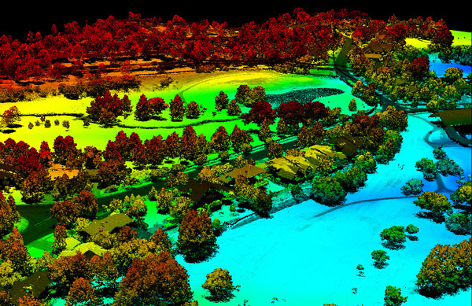
1. Data formats and creation methods
3dgolfcourse.com
Notes:
What makes data geographic?
Wide variety of data sources and methods
Raster and vector based data sources
Information about a place in some form—often now through GIS based techniques
RASTER DATA:
Comprised of raster cells—all the same size and all with a value
VECTOR DATA:
A representation of the world using points, lines, and polygons. Vector models are useful for storing data that has discrete boundaries, such as country borders, land parcels, and streets.
(Jerry uses vector data, I use raster but I don’t call it that)

Slide 9
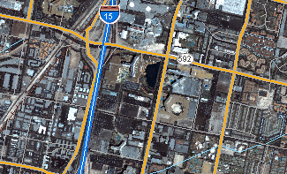
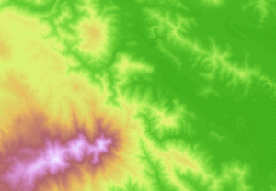
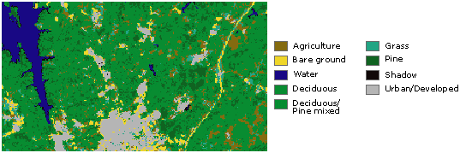
Basemaps
Continuous data
Thematic (discrete) data
Notes:
In its simplest form, a raster consists of a matrix of cells (or pixels) organized into rows and columns (or a grid) where each cell contains a value representing information, such as temperature. Rasters are digital aerial photographs, imagery from satellites, digital pictures, or even scanned maps.
Data stored in a raster format represents real-world phenomena:
Thematic data (also known as discrete) represents features such as land-use or soils data.
Continuous data represents phenomena such as temperature, elevation, or spectral data such as satellite images and aerial photographs.
Pictures include scanned maps or drawings and building photographs.
Common raster maps? Temperature data (interpolated), land cover, classified remote sensing imagery
Questions you could ask of a land cover map—what percentage of an area is covered by various land cover types. What’s the relationship between type of land cover and other characteristics: elevation, proximity to certain features, etc.?

Slide 10
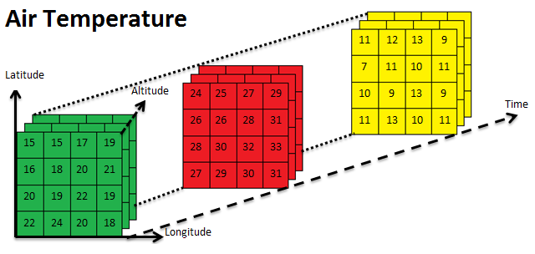
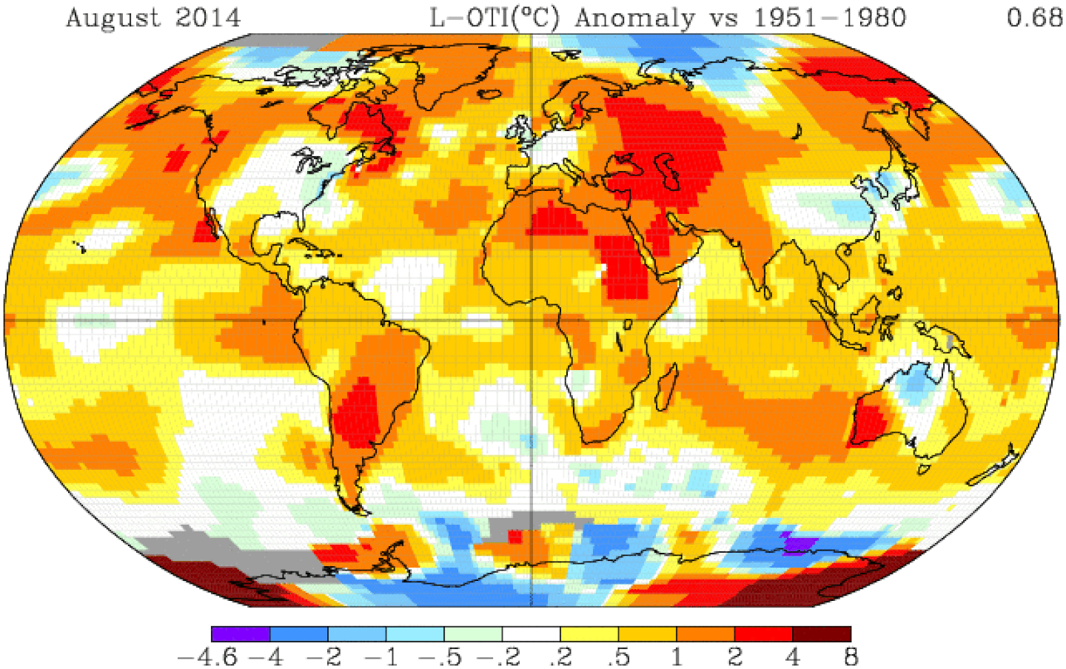
Arrays (multi-dimensional)

Slide 11
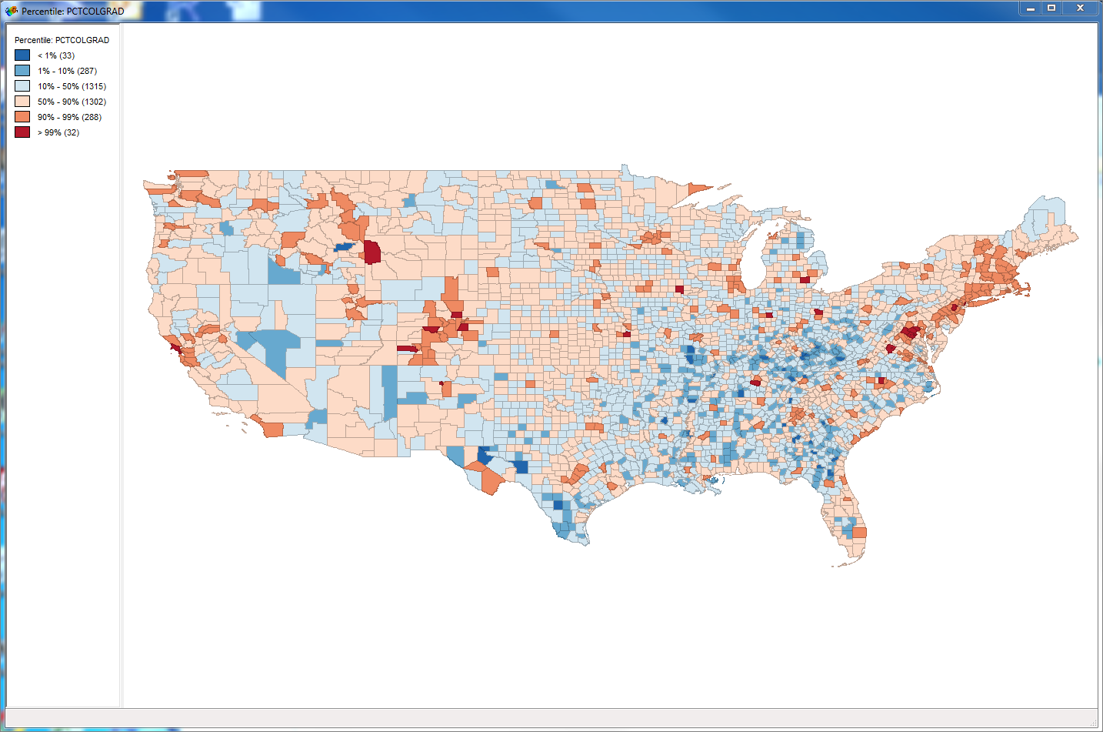
2. Methods of analysis
Spatial clustering
Spatial lag/influence
Space/time geography

Slide 12
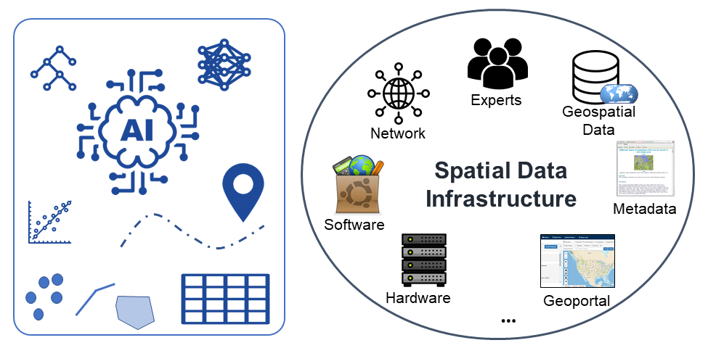
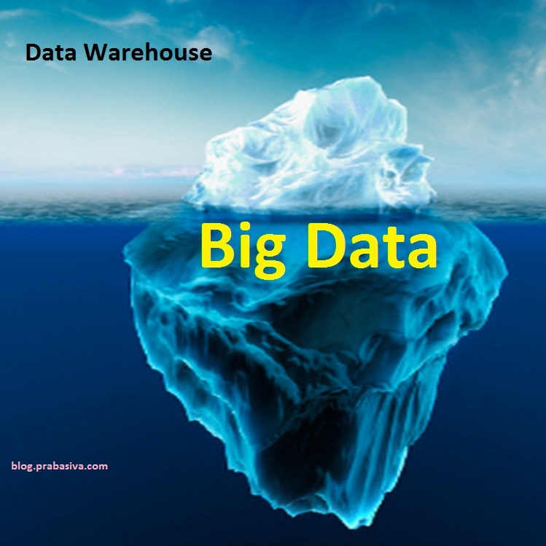
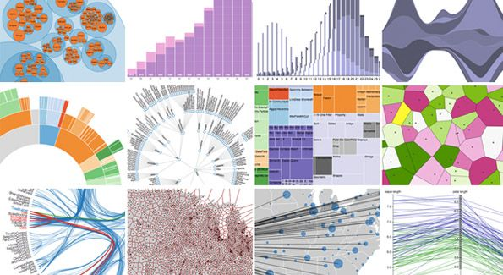
3. Data workflow
Notes:
More recently, new generation of work on quantitative geography drawing on increased computing power, GIS software, and increasing availability of “big data”
Methods for managing and analyzing datasets of multiple terabytes

Slide 13
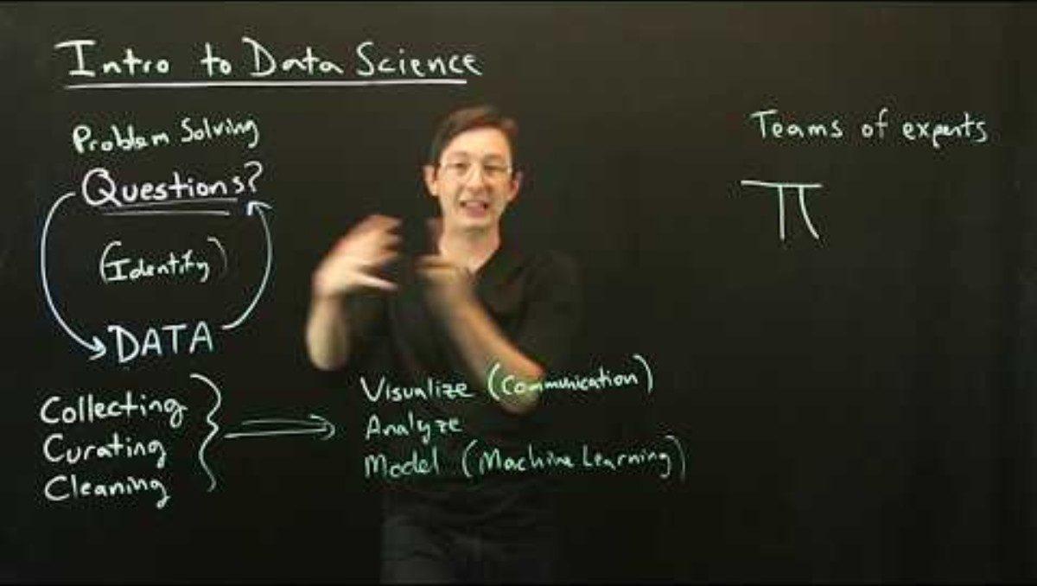
How is data science different? (Or is it?)
Notes:
More recently, new generation of work on quantitative geography drawing on increased computing power, GIS software, and increasing availability of “big data”
Methods for managing and analyzing datasets of multiple terabytes

Slide 14
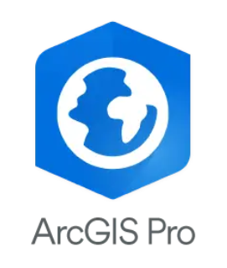



Why code?
Open-source model (low/no cost)
Reproducibility
Shareability
Spatial & non-spatial data
Advanced analytical tools
Notes:
More recently, new generation of work on quantitative geography drawing on increased computing power, GIS software, and increasing availability of “big data”
Methods for managing and analyzing datasets of multiple terabytes

Slide 15
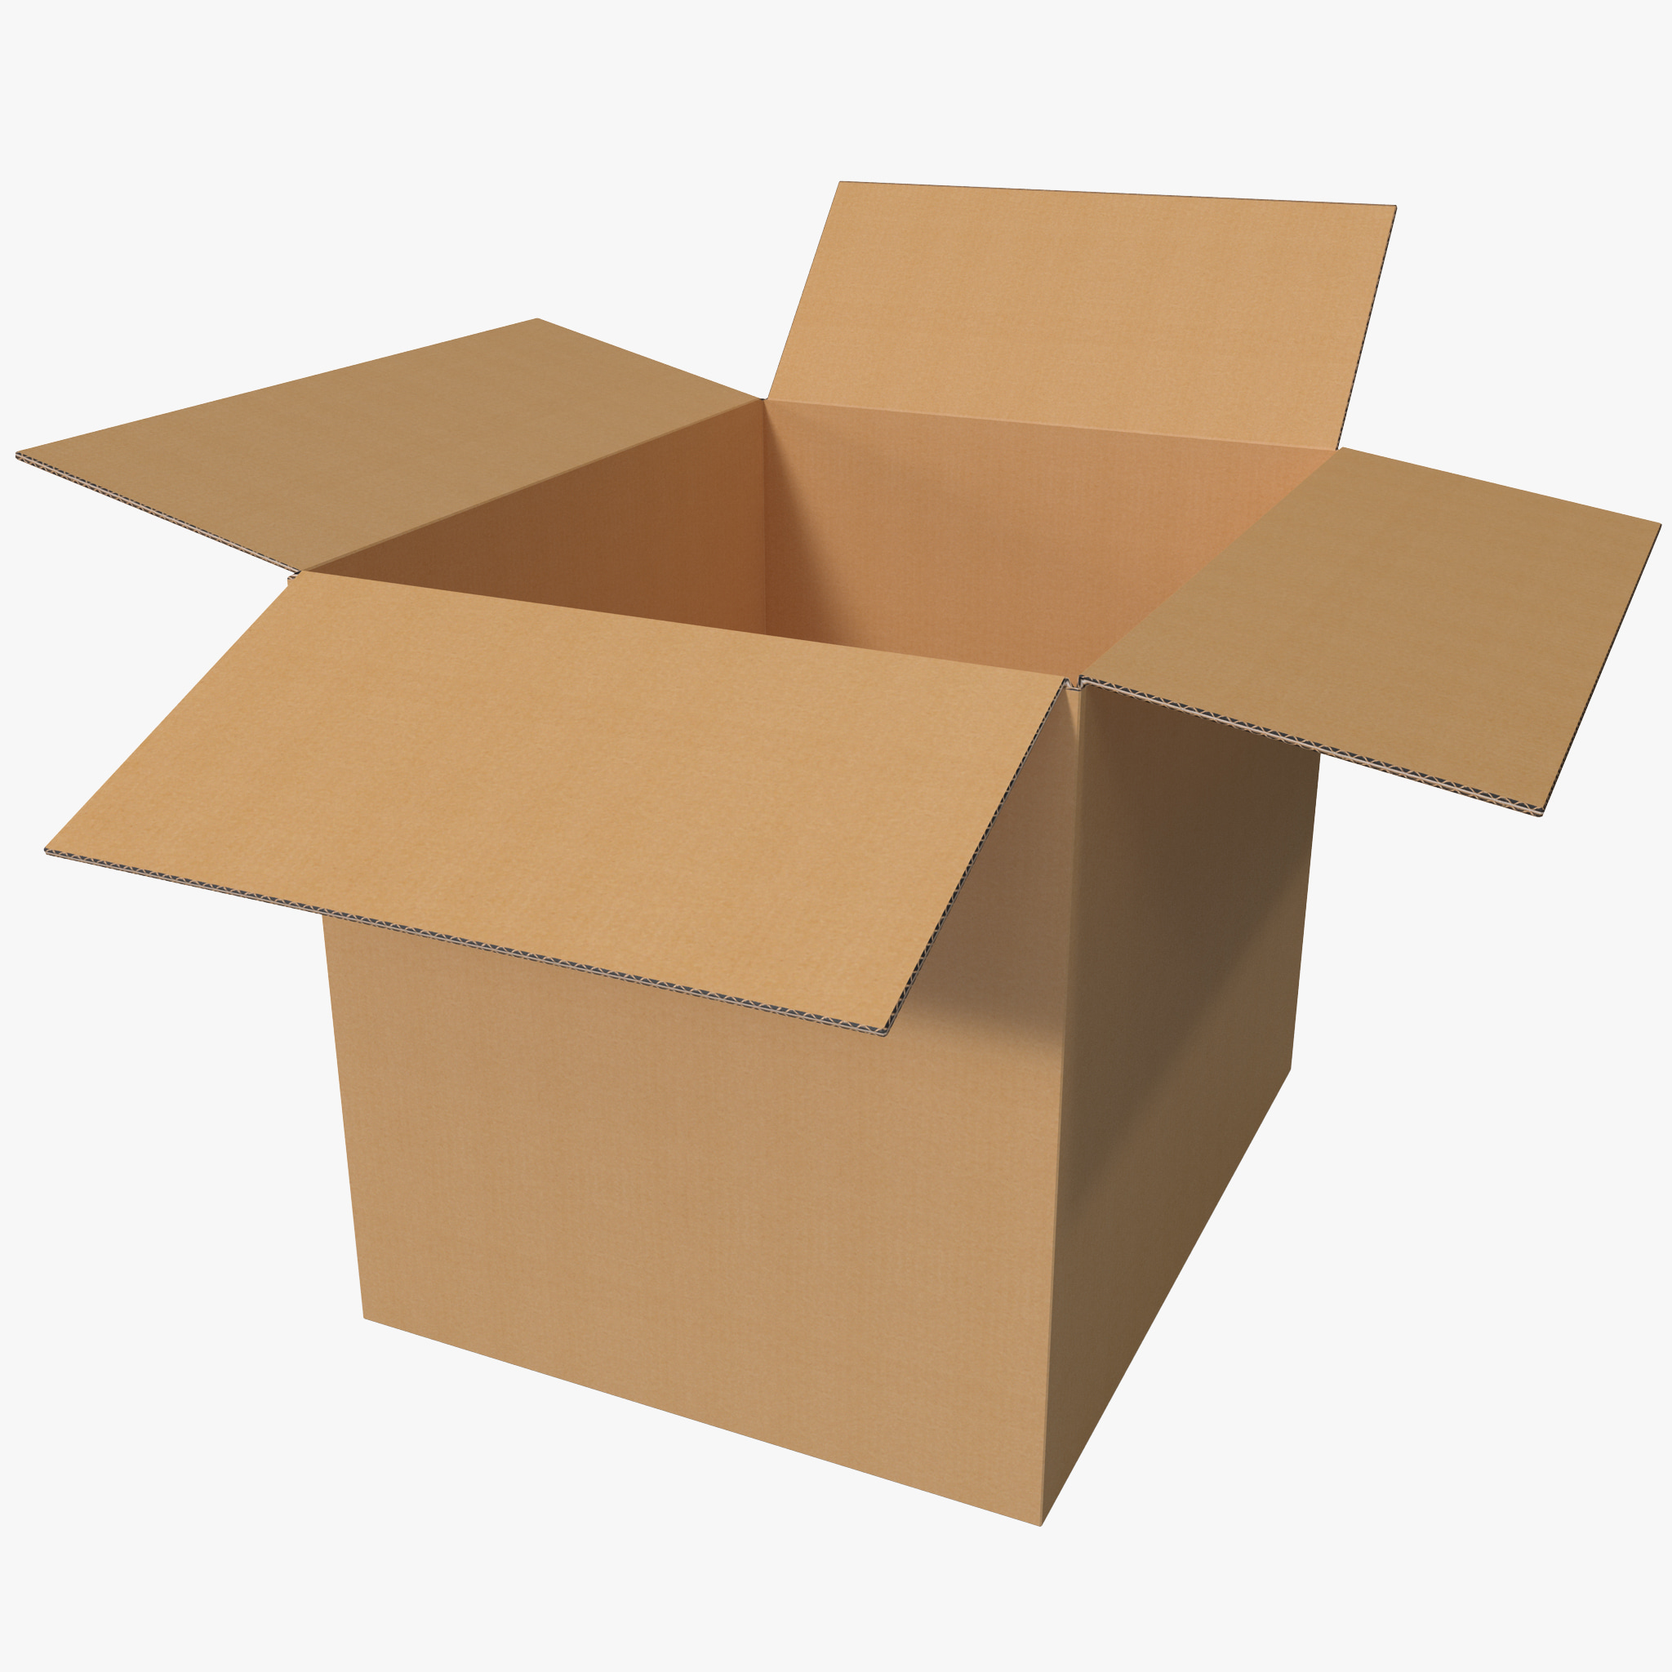
Object-oriented programming
Data are stored within a coding environment using structures called objects
Notes:
More recently, new generation of work on quantitative geography drawing on increased computing power, GIS software, and increasing availability of “big data”
Methods for managing and analyzing datasets of multiple terabytes

Slide 16
What can go inside an object?
Single values (Vectors): Apples, oranges, or bananas
Groupings of data (Lists): All the vegetables in a supermarket; All the meats in the same market, etc.
Statistical tables (Data frames/matrices): Addresses, coordinates, and sales figures for a supermarket

Slide 17
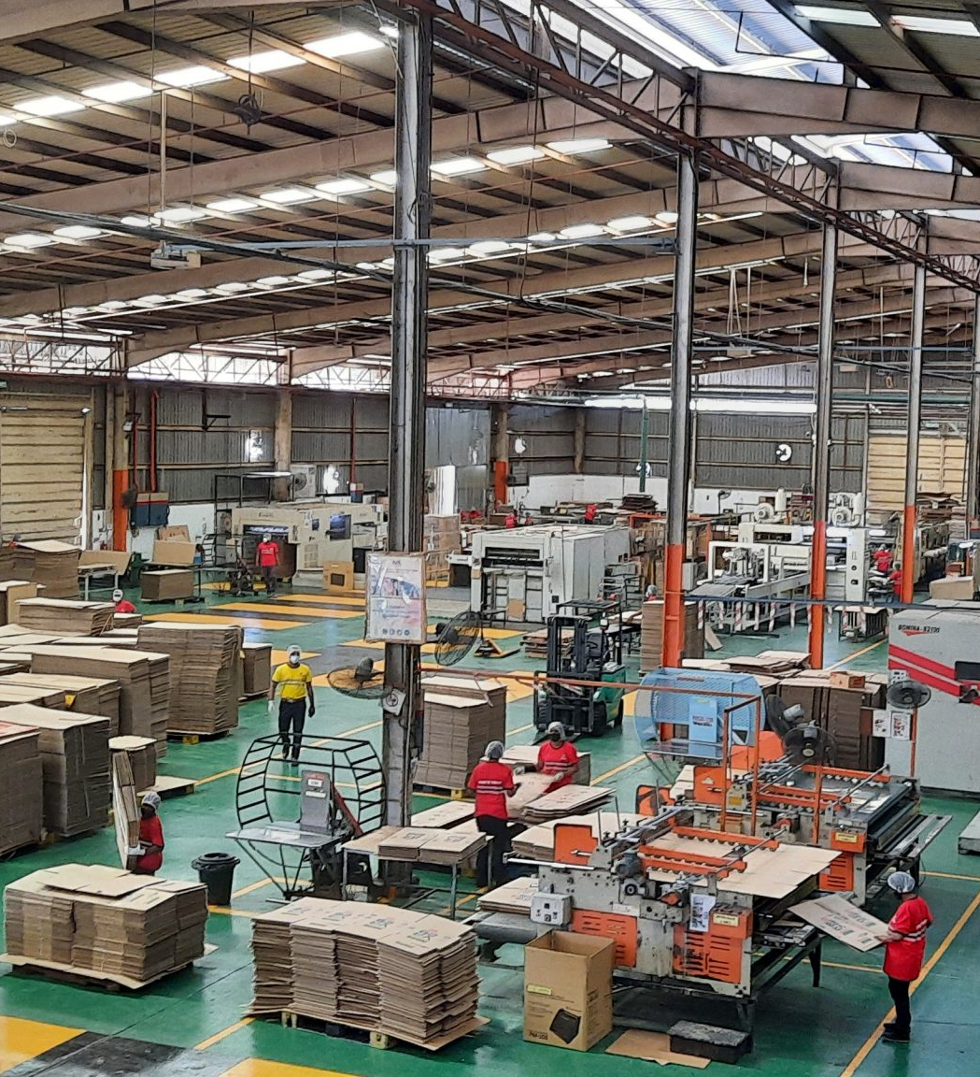
You can manipulate objects
Run calculations
Summarize values
Create statistical models
Join/merge them with other objects

Slide 18
Article search
Find an article published since 2020 on a topic of interest to you that used Rstudio as part of the analysis.
What research question was this article asking?
What data did it use?
How was R/Rstudio part of the process?

Slide 19
Next time: Getting started with R!
Install R/Rstudio BEFORE class
Take the Introductory Survey
Answer discussion post: what does an A look like for you?
What we will cover:
How to clone the course repository (“repo”)
Get started using data in R: Script S01-1

